Slide 1


Slide 2
Given certain data, can we predict if the Orders-established-measure will exceed the median amount in a certain county?

Slide 3
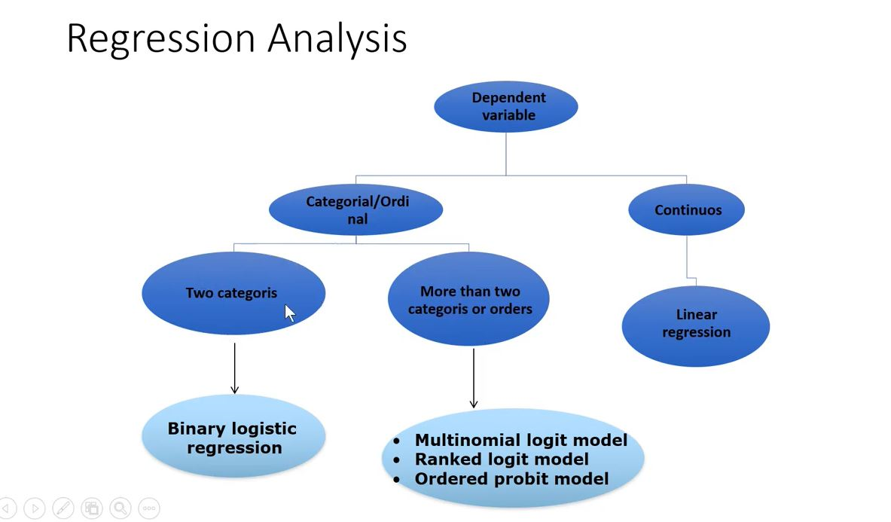



Orders-established-measure
exceed the median amount
Or not

Slide 7
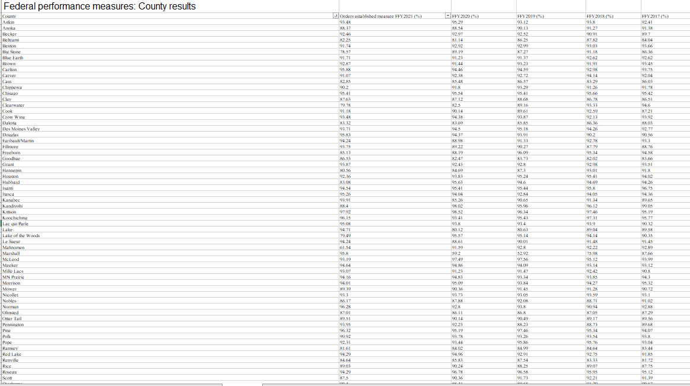

Slide 8
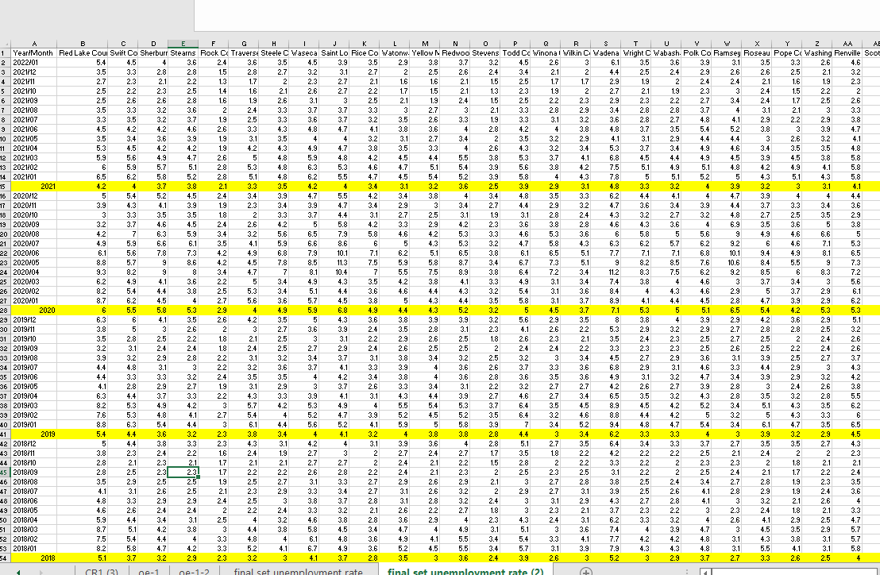
Local Area
Unemployment
Statistics (LAUS)
Mn.gov

Slide 9
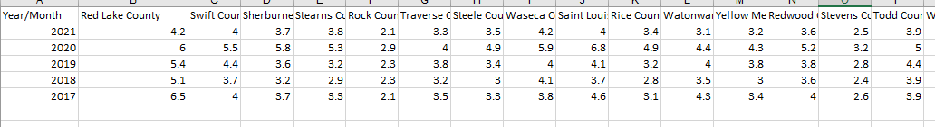

Slide 10
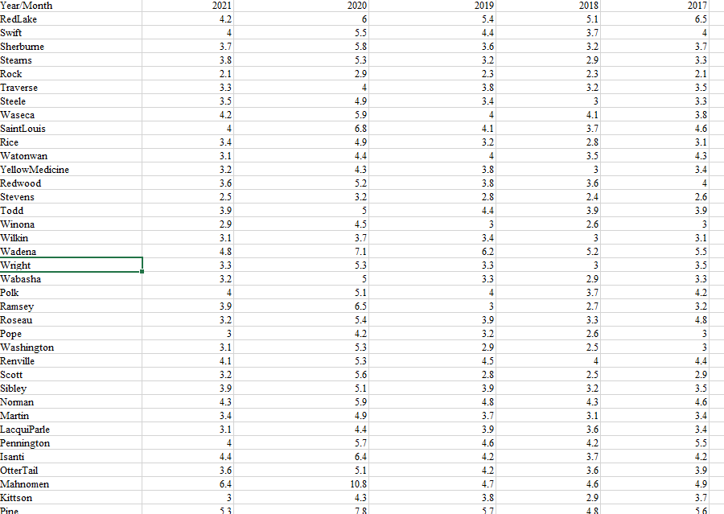

Slide 11
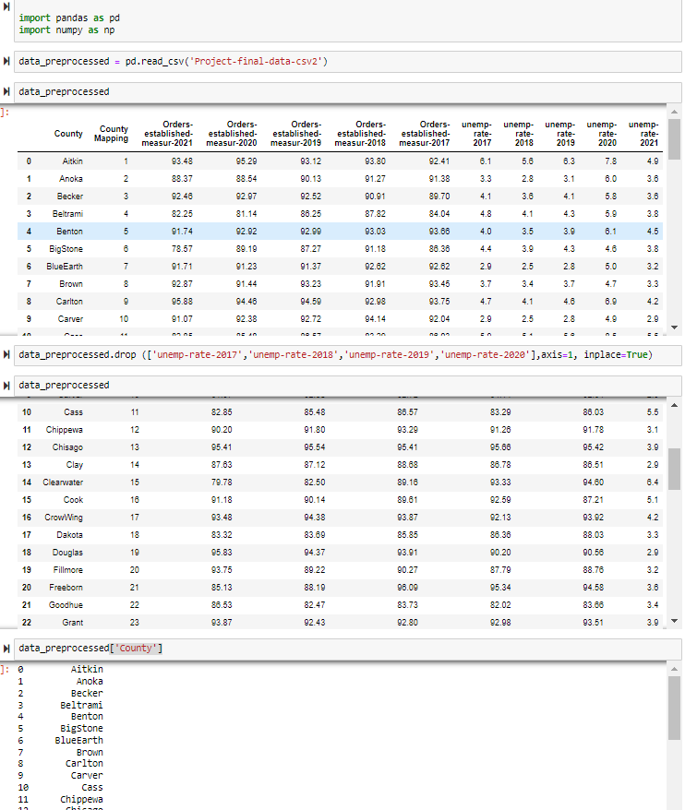
Read and eyeball data
Text needs to be in float format
Using mapping for text

Slide 12
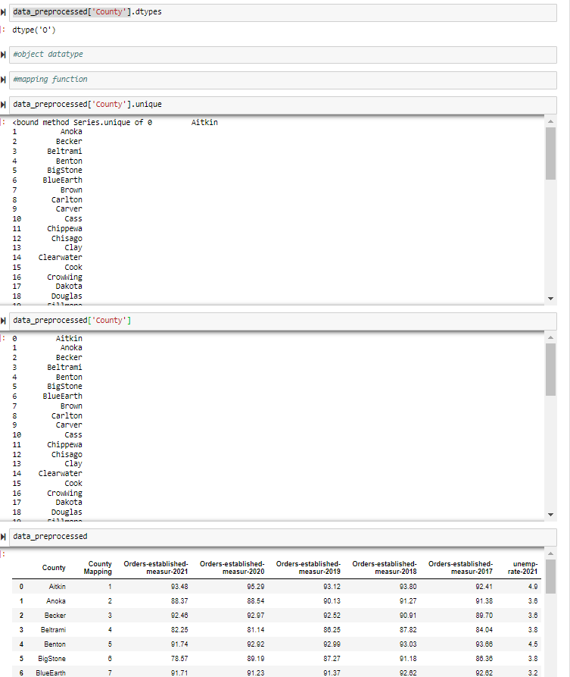
Text is object

Slide 13
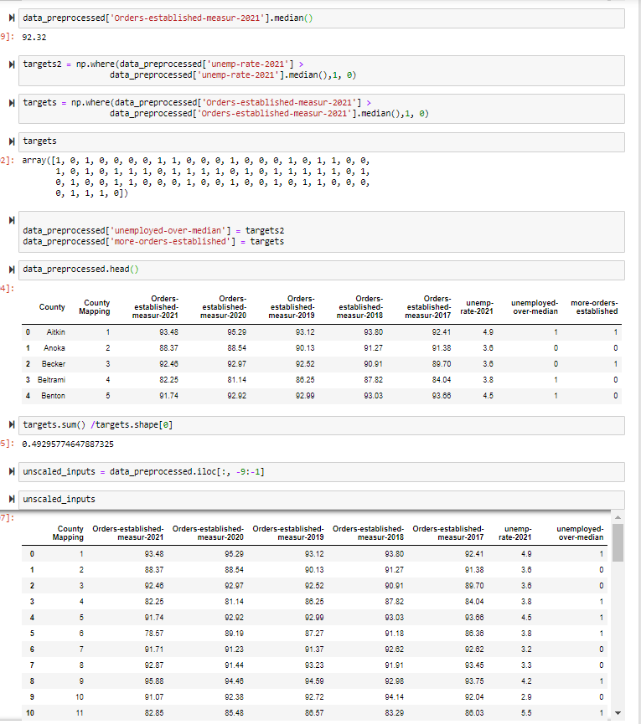
Looking at the median
Creating target
Using Iloc to pick columns

Slide 14
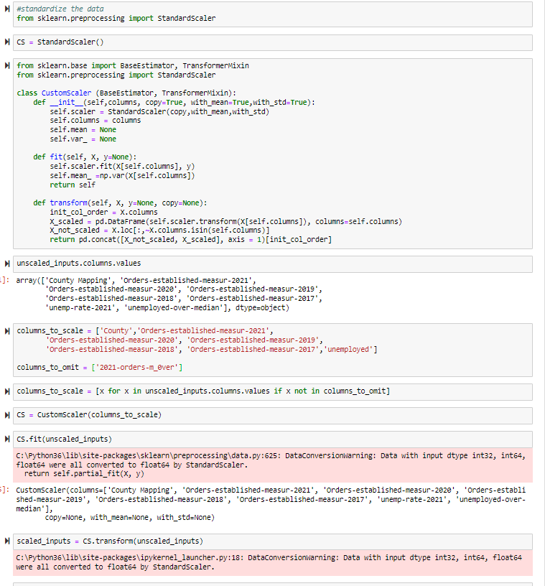


We are standardize data
Using standard scaler object
Custom scaler doesn’t
Standardize all data to
Leave dummy variables
untouched
Omitting dummy from standardization
Basically same thing
Augment code
We need to fit input data
this contains Information
Mean and standard deviation
Columns_to_scale
Works as a loop

Slide 15
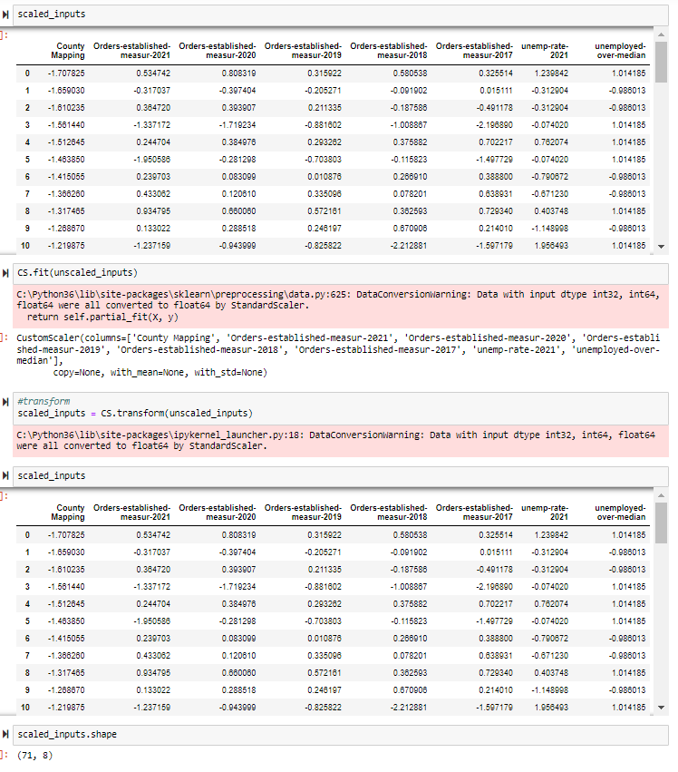
Or We can transform
unscaled input. This will
standardize the data

Slide 16
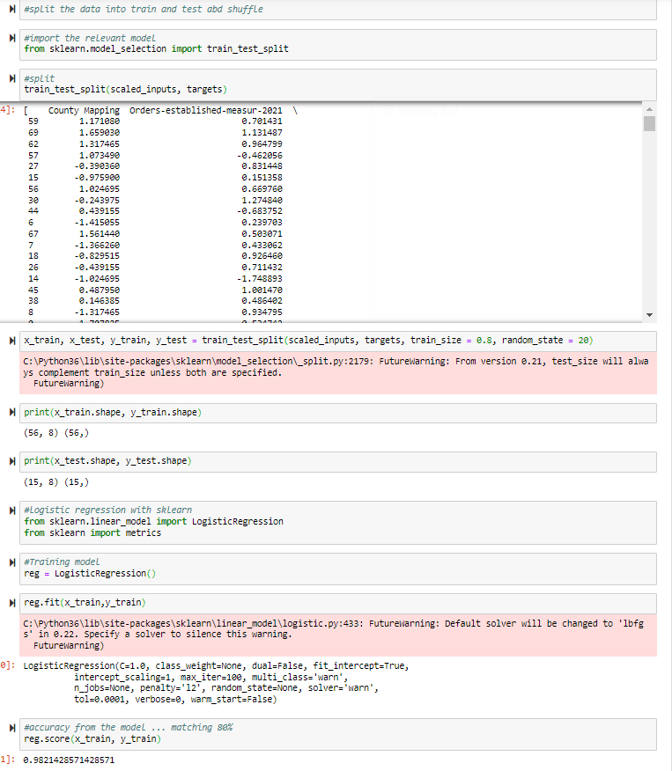
We want to prevent
Overfitting we do that by
hiding a part of the data
For testing.
We want to train and test
the data
We split data into train data
And test data
We check the shape of
The train test splits
56 observation with
8 variables
Targets are a vector of length
56 (the more orders
Established)
This is the default usually 80% train – 20% test split
Importing logistic regression
Module
Fit our data with our model
Model accuracy

Slide 17
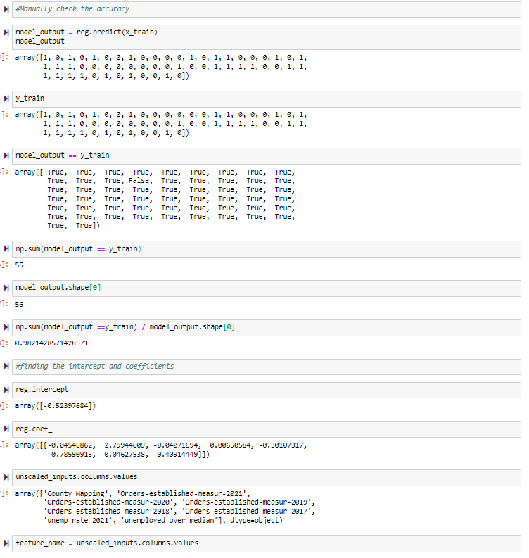
To better understanding
Accuracy You want to
manually check accuracy
In our train data we find
98%match
This is prediction of model
Output xtrain
Predict model output ytrain
If elements (x,y train) are
guessed correctly
its True if not its false
Compare element of
two variables
guessed correctly
with True False
Number of true entries
Total number of outputs
Divide true entries
by outputs = same output as
accuracy
Side note Log r
Is about determining certain
Coefs which we apply
to inputs for final results
coefs numerical or constant
quantity placed before
and multiplying the variable
in an algebraic expression
Coef and what variables
They belong to
Creating variable with
coef info

Slide 18
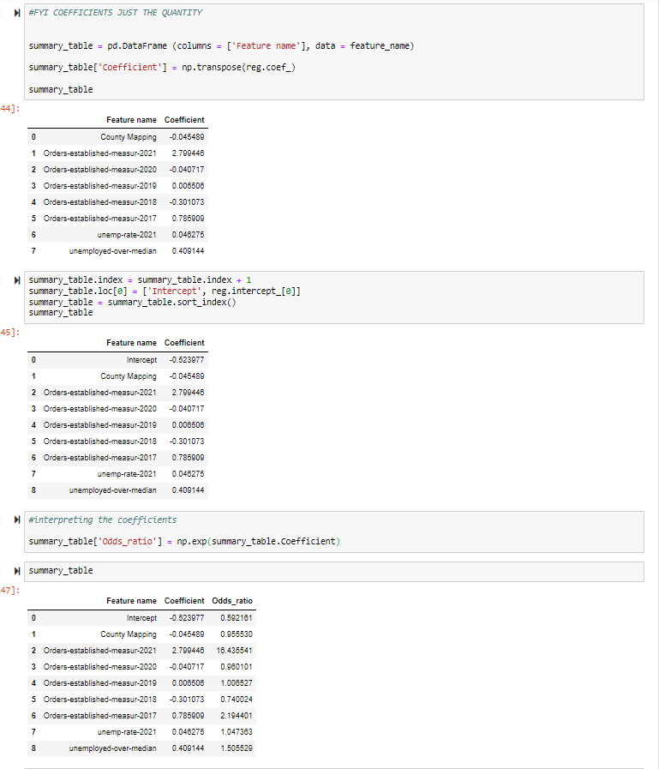
arrays are rows
so we transpose
I want to create a dataframe
With intercept, feature name
And and corresponding coef
Adding the intercept / bias
-Bigger the feature is
from the intercept stronger
The coef
Finding the exponential of coefs
So that we can sort the columns
By most important

Slide 19
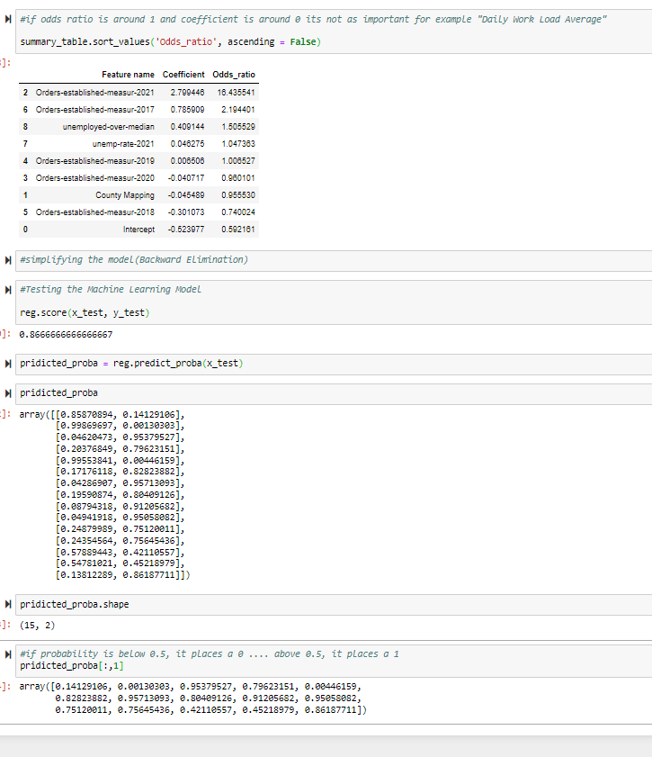



A coef of 0 implies that no matter
The feature value, we will multiply
By 0 ( in the model)
For a unit change in the standardized
Feature, the odds increase
By a multiple to the odds
Ratio (1 = nochange) .. Ex
Odds * odds ratio = new odds
5:1 * 2 = 10:1
5:1* 0.2 = 1:1
5:1 * 1 = 5:1
A feature is not particularly important
If its coef is around 0
If its odds ratio is around 1
Testing our data
This is data the model hasn’t seen. Testing the train wouldn’t change anything because were not testing. Testing train will cause new data to fail.
-Given the data, we Predict if
Orders-established-measure
will exceed or not exceed
the median amount in a certain county 86% of the time
Another way
This is better we can get the
Probability
Probability of getting 0 or 1
Returns the probability
estimates for all possible
outputs (classes)
15 test 0bservations and
2 columns. 1st is 1 snd being 0
We want the probabilities of 1

